Slide 1
Hands On Lab!
15 minutes

Slide 2
Connect to Azure Rm
Create a new folder called digital_infra_state
Create a provider.tf file and use use Azure Rm https://registry.terraform.io/providers/hashicorp/azurerm/latest/docs
Use the latest version of Azure Rm
Use local state
Run terraform init to validate that everything is correctly initialized

Slide 3
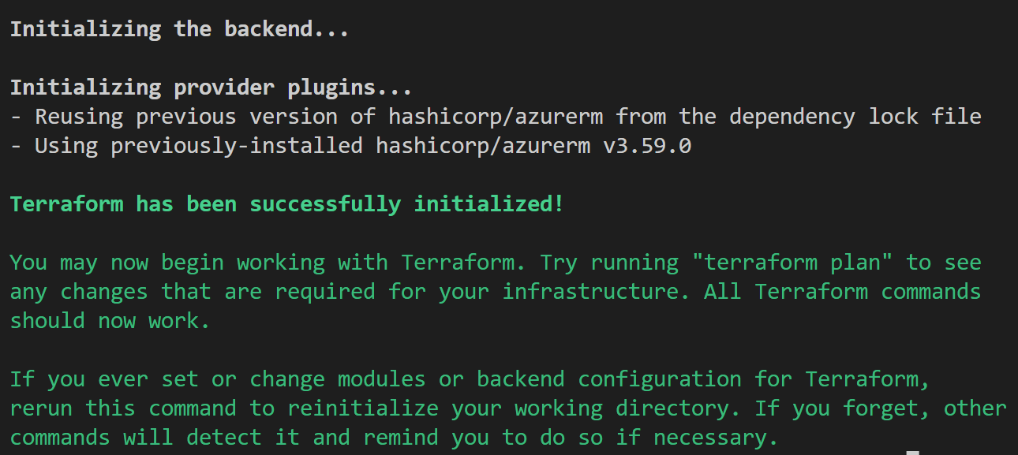
Connect to Azure Rm

